Slide 1
Food, Drug and Nutrition related Issues with role of civil Society wdydr fT!IO iy fmdaIK .eg`: ;=< isú,a iudcfha ld¾h Ndrh
P.MADARASINGHE
Rtd. Assistant Director, Food Control Administration,
Ministry of Health
Director, Food Products Evaluation & Consultative Services,

Slide 2

Prevalence of stunting in children under 5 (%)
2010–2019 17.3%
Stunting is the impaired growth and development that children experience from poor nutrition and repeated infection
Child stunting refers to a child who is too short for his or her age.
Stunting is a contributing risk factor to child mortality and is also a marker of
inequalities in human development. Stunted children fail to reach their physical and cognitive potential.

Slide 3
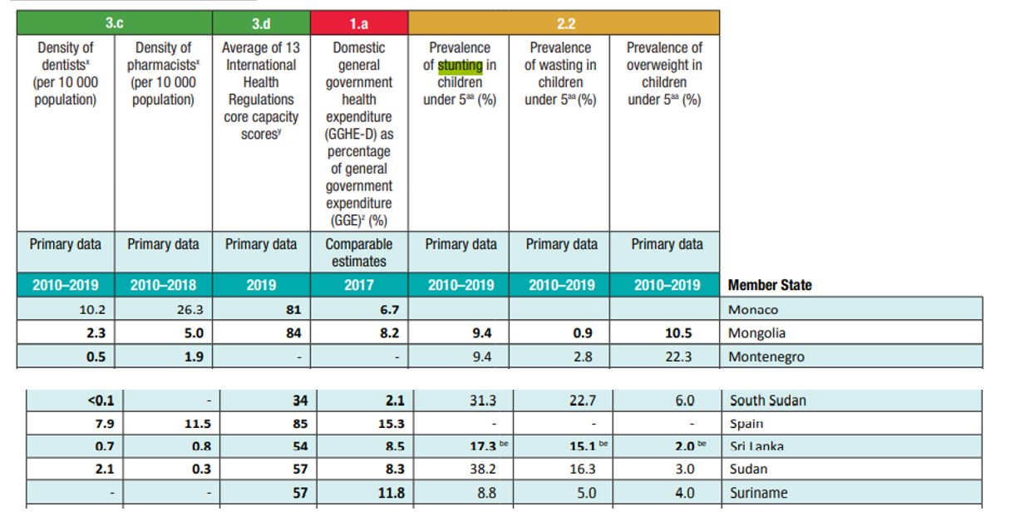
Prevalence of stunting in children under 5 (%)
2010–2019 17.3%
……

Slide 4
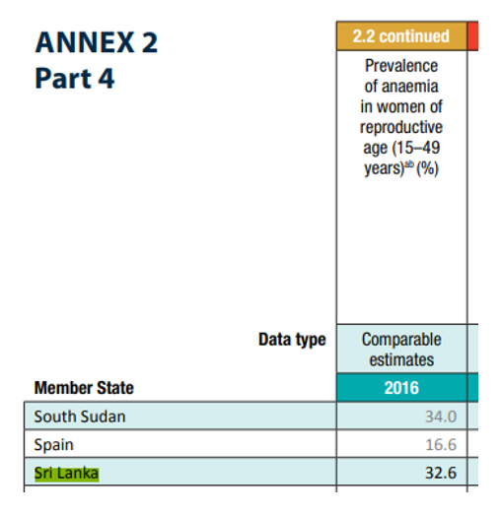
Prevalence of anaemia in women of reproductive age (15-49 years) 32.6%

Slide 5
Prevalence of stunting in children under 5 (%) Boys 19.8%, Girls 18.7%
WHO-World Health Statics 2019 ( Page 112)
Prevalence of stunting in children under 5 (%) Boys 19.8%, Girls 18.7%
No one is bothered about this situation.
In Sri Lanka we have wonder food specially prepared for 1 to 3 years, 3 to 5 years.
  with Exaggerated, unethical, violatory descriptions. i.e
Inclusion of crafted/fabricated words on product labels i.e " Bifidus", "Immunofortis"
Use of superlative terms i.e. “Gold”, “Premium”
Inclusion of controversial and unproven descriptions i.e DHA for brain development
Declaration of special characteristics without obtaining approval of the Chief Food Authority.
Over emphasize of minute nutrient component and nutrient functions.
Labels containing brand endorsements.

Slide 6
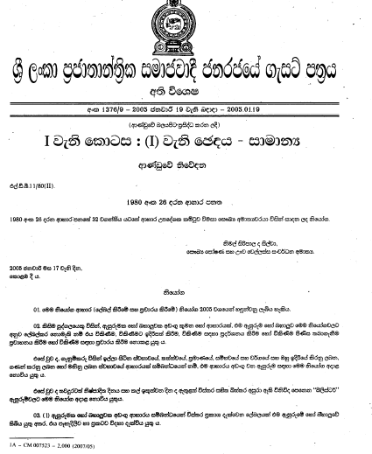
Food (Labelling & Advertising) Regulations -2005
Published in Govt. Gazette
Extraordinary No.1376/9
Effective from
January 19, 2005

Slide 7
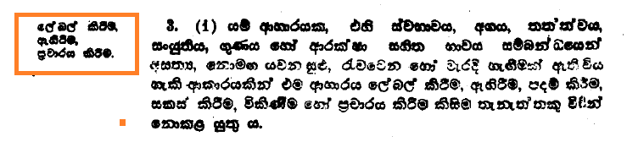
Section 3 of the Food Act.
Claims which are false, misleading, deceptive or likely to create an erroneous impression, are prohibited under the Food Act.
  Section 3(1) : “No person shall label, package, treat, process, sell or advertise any food in a manner that is false, misleading, deceptive or likely to create an erroneous impression, regarding its character, value, quality, composition, merit and safety.”

Slide 8
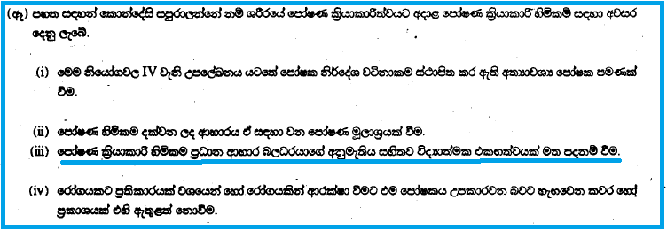
fmdaIK l%shdldrS ysñlï m%ldY ioyd wod,jk kS;s
Specified in Schedule IV Explanatory Notes (d) (i) of the Labelling Regullations
Nutrient Function Claims should be based on scientific consensus which is supported the Chief Food Authority.

Slide 9
Special characteristics to be approved by CFA wdyrhl úfYaI .;s ,laIKhla we;snjg jk m%ldY
Section 12
No label or advertisement relating to food shall contain a statement or claim thereon that such food has special characteristics
unless approved by CFA.
wdyrhl úfYaI .;s ,laIKhla we;snjg m%ldYhla
m%Odk wdydr n,Orhdf.a wjirh rys;j
f,an,hl fyda oekaùul m%ldYh fkdl< hq;=h'

Slide 10
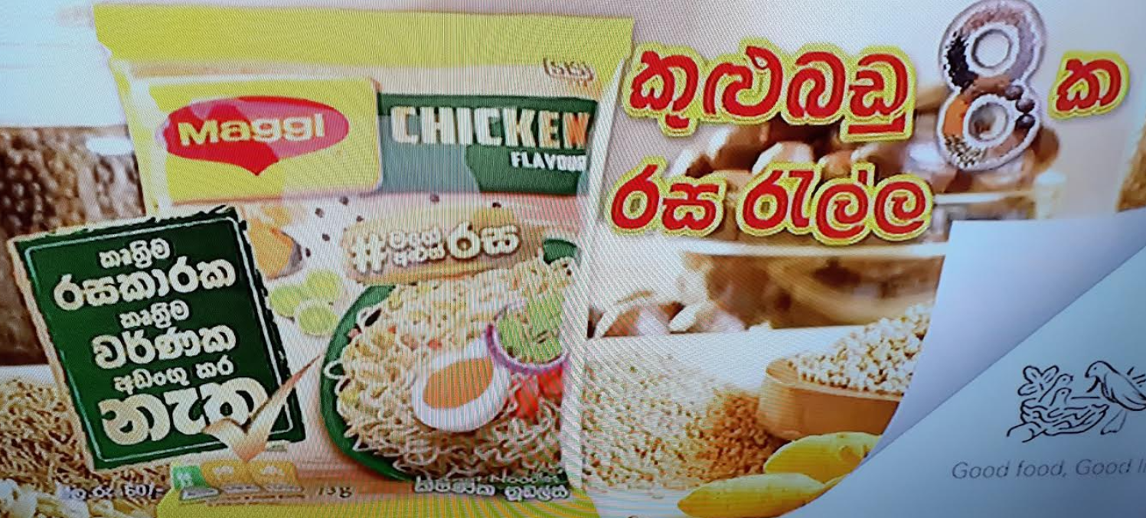
Maggi- lD;%Su rildrl ke;' lD;%Su j¾Kl wvx.=lr ke;'

Slide 11
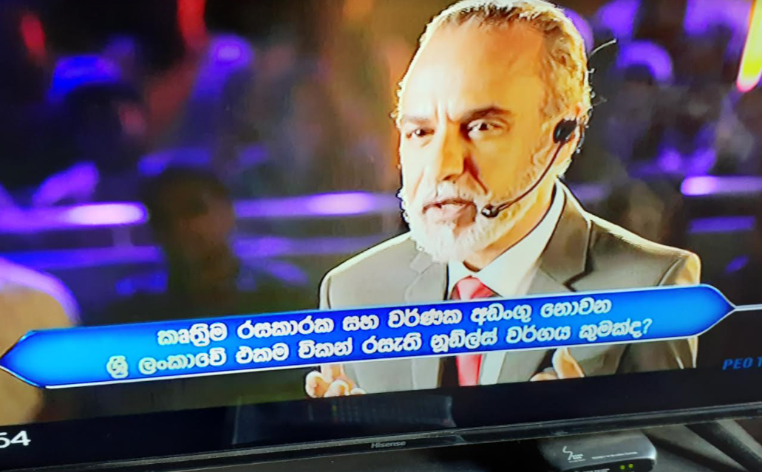
Maggi- lD;%Su rildrl ke;' lD;%Su j¾Kl wvx.=lr ke;'
by; m%ldIh fi!LH n,OdrSka wkqu; lrkjdo ?
Section 12 of the Labelling Regulations
wdyrhl úfYaI .;s ,laIKla we;snjg m%ldYhla m%Odk wdydr n,Orhdf.a wjirh rys;j f,an,hl fyda oekaùul m%ldYh fkdl< hq;=h'

Slide 12
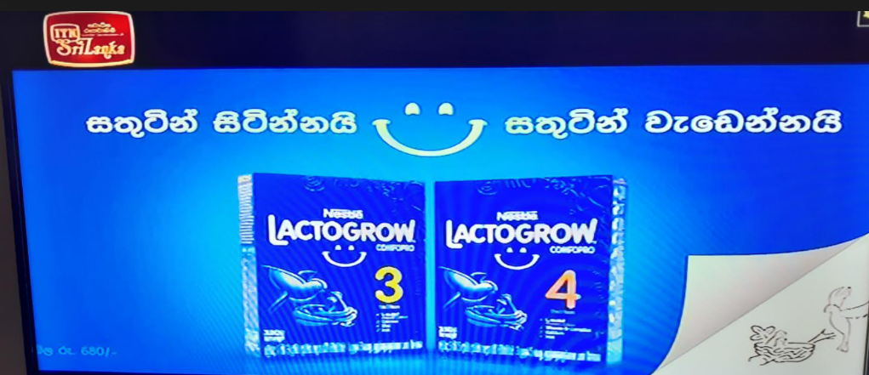
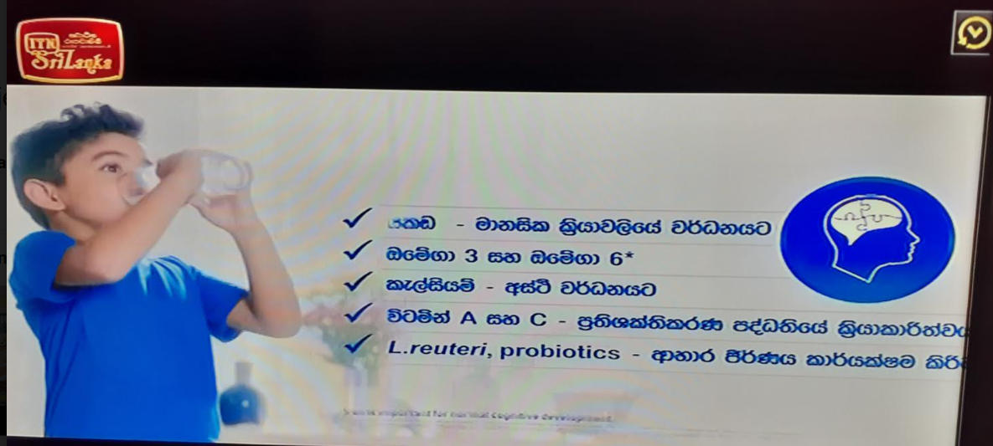
fuu m%ldIh fi!LH n,OdrSka wkqu;sh ,ndf.k ;sfnkjdo ?
Section 12 of the Labelling Regulations
wdyrhl úfYaI .;s ,laIKla we;snjg m%ldYhla m%Odk wdydr n,Orhdf.a wjirh rys;j f,an,hl fyda oekaùul m%ldYh fkdl< hq;=h'

Slide 13
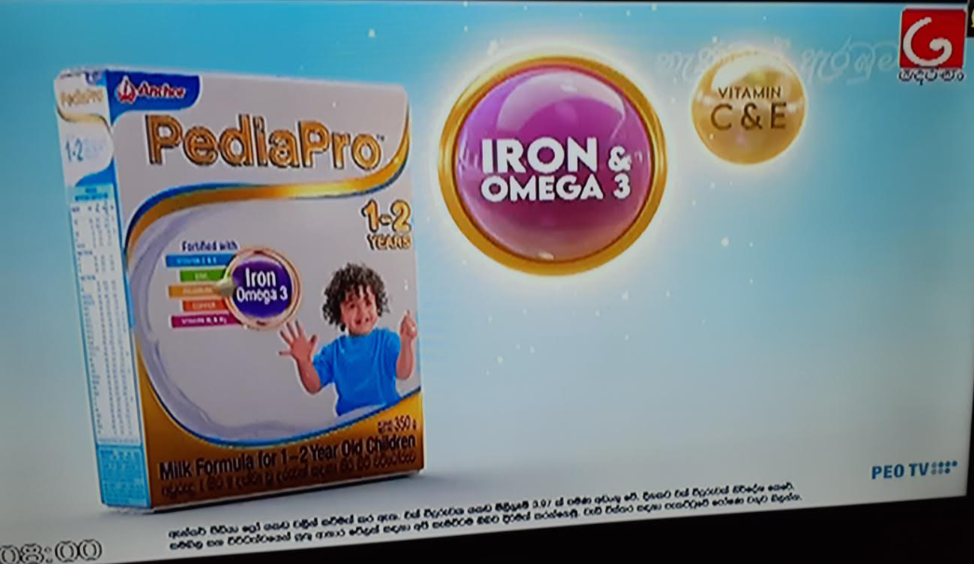
Milk formula for 1 to 2 years children
jir 1 isg 2 olajd ,uqka ioyd jk lsrs jÜfgdarejla f,I ix>gl we;s nj ;yjqre lr Section 12 of the Labelling Regulations hgf;a wjiirh ,ndf.k ;sfnkjdo ?
wdyrhl úfYaI .;s ,laIKla we;snjg m%ldYhla m%Odk wdydr n,Orhdf.a wjirh rys;j f,an,hl fyda oekaùul m%ldYh fkdl< hq;=h'

Slide 14
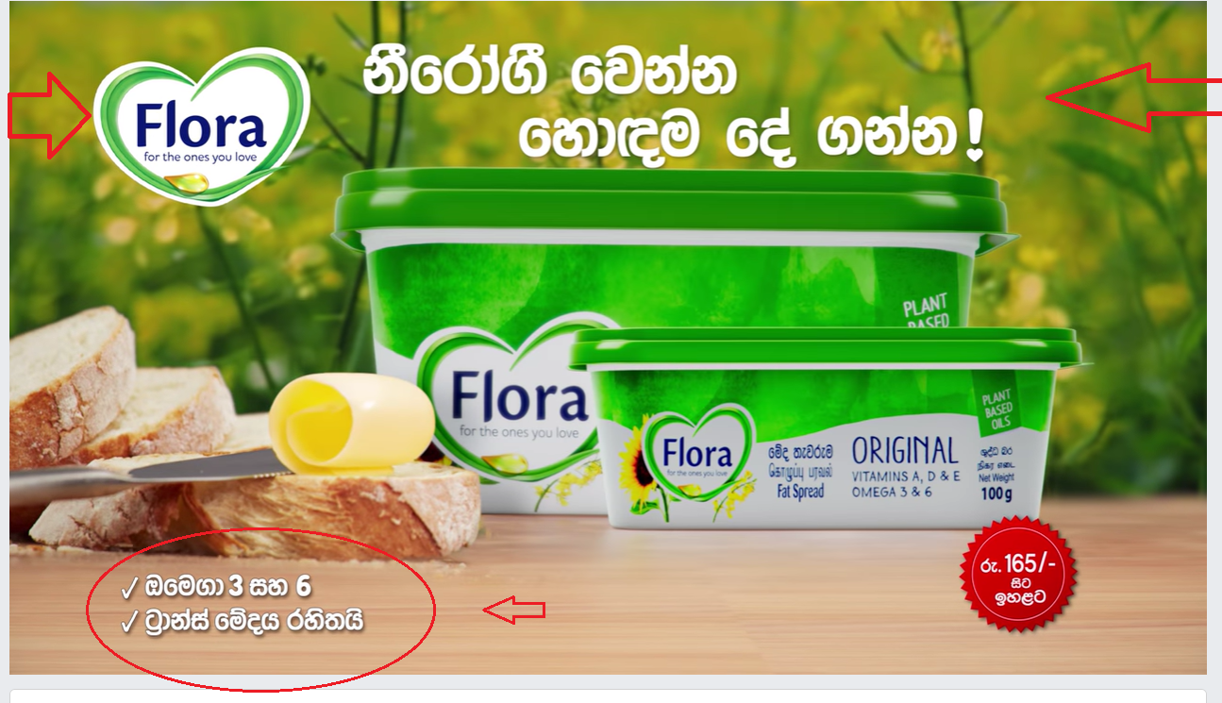

Slide 15

FLORA – ksfrda.S fjkak fydou wdydrhlao ?
by; m%ldIh fi!LH n,OdrSka wkqu; lrkjdo ?
Section 12 of the Labelling Regulations
wdyrhl úfYaI .;s ,laIKla we;snjg m%ldYhla m%Odk wdydr n,Orhdf.a wjirh rys;j f,an,hl fyda oekaùul m%ldYh fkdl< hq;=h'

Slide 16
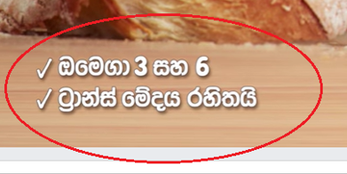
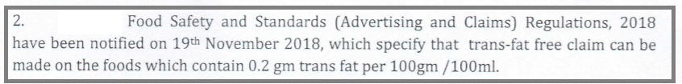
Trans fat free claims
Section 12 of the Labelling Regulations
wdyrhl úfYaI .;s ,laIKla we;snjg m%ldYhla m%Odk wdydr n,Orhdf.a wjirh rys;j f,an,hl fyda oekaùul m%ldYh fkdl< hq;=h'

Slide 17
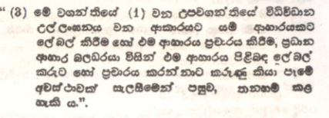
Defective product labels or advertisements:
The Chief Food Authority (Director General of Health Services), after giving the labeller or advertiser of any food product an opportunity of being heard, prohibit the labelling or advertising of such food product.
  Section 3(3) of the Food (Amendment) Act No. 20 of 1991

Slide 18
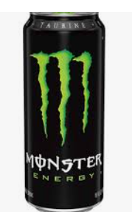
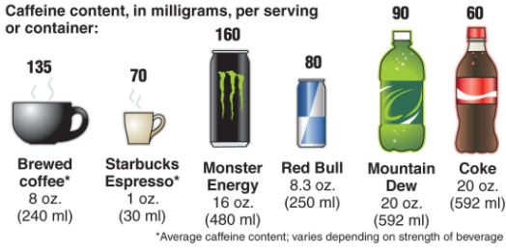
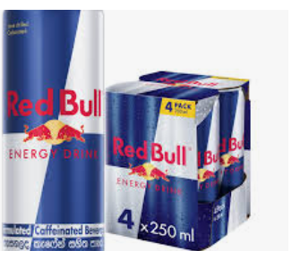
wê lef*aka idxO%Khla we;s mdkhka ly meye;s ixfla; hgf;a wf,ú lrk tlu rg › ,xldjhs
Mmm

Slide 19
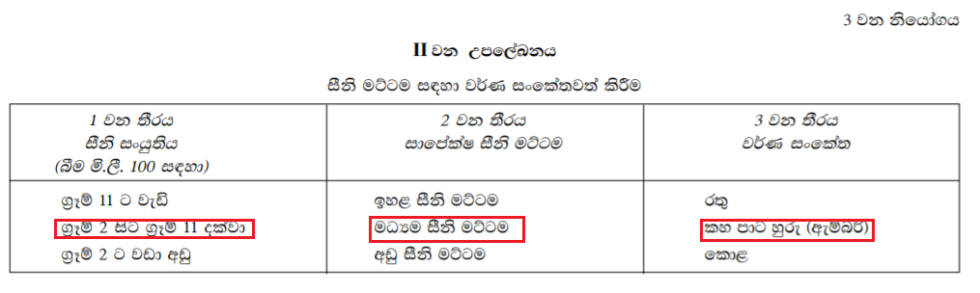
wê lef*aka idxO%Khla we;s mdkhka ly meye;s ixfla; hgf;a wf,ú lrk tlu rg › ,xldjhs
Mmhttp://www.eohfs.health.gov.lk/food/index.php?option=com_content&view=article&id=18&Itemid=159&lang=en

Slide 20
The 2008 Chinese milk scandal
Incident in China involving milk and infant formula, adulterated with melamine.
China reported an estimated 300,000 victims,six infants dying from kidney stones and other kidney damage, acute kidney failure 860 babies hospitalized.

Slide 21
Melamine scandal
According to WHO reports 82% of the children ill were 2 years of age or below.
The chemical Melamine have been added to milk in order to cause it to have a higher protein content.
2013 - Dicyandiamide (DCD) contaminated milk powders

Slide 22
Be an informed
& vigilant consumer
oekqj;a mdrsfNda.slfhla f,i
NdKav f;dard .ksuq

Slide 23

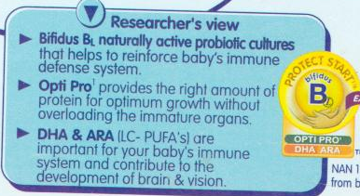



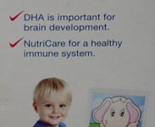


Slide 24
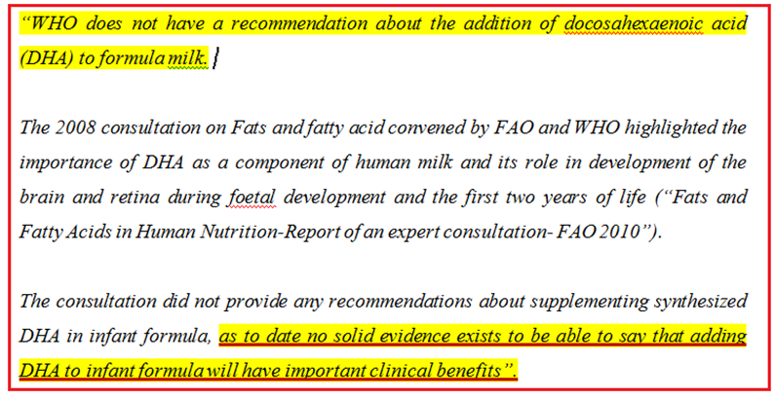

Slide 25
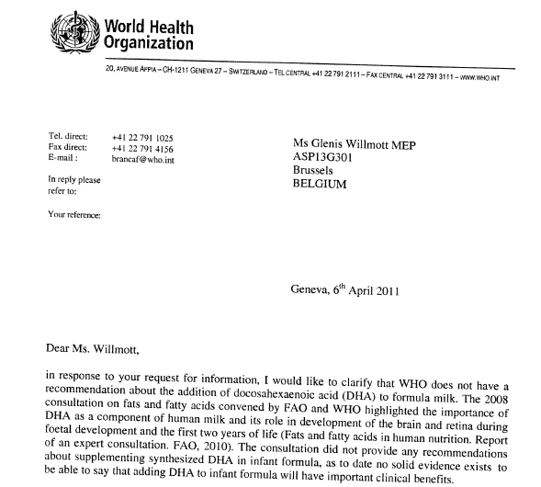

Slide 26
Special characteristics to be approved by CFA
Section 12
No label or advertisement relating to food shall contain a statement or claim thereon that such food has special characteristics
unless approved by CFA.
wdydrhl úfYaI .;s ,laIKhla we;snjg m%ldYhla m%Odk wdydr n,Orhdf.a wjirh rys;j f,an,hl fyda oekaùul
m%ldY fkdl< hq;=h

Slide 27
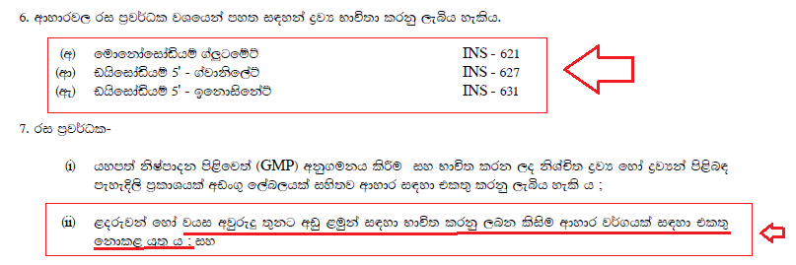
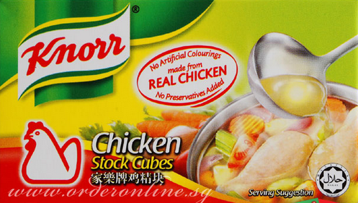
wxl 1795$51 - 2013 fmnrjdß ui 01 jeks isl=rdod - 2013'02'01 fuu ksfhda. 2013 wdydr ^rildrl øjH iy ri m%j¾Ol& ksfhda. hkqfjka y÷kajkq ,nk w;r tu ksfhda. 2014 cQ,s 01 jeks Èk isg n,d;aul úh hq;= h' ls%hd;aul oskh 2015 ckjdrs olajd miqj l,a ouk ,oS
Knorr Chicken Cubes
Flavour Enhancers – E 621, E 627, E 631

Slide 28
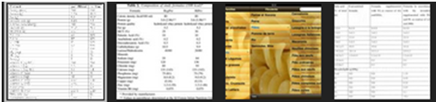
Letter size used to indicate mandatory labelling information
The Section 5 (1) (f) reads as follows:
“The declarations, other than the declarations in paragraph (e)* shall be conspicuously printed in bold type letters of not less than 1.5 millimeters in height”.

Slide 29
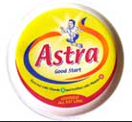
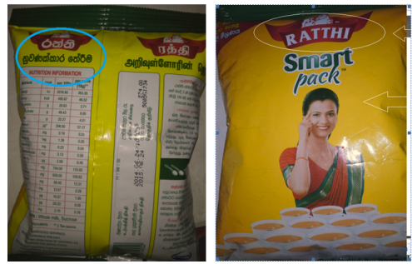
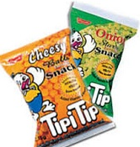
What do you know about these products?
Difference between Full Cream Milk Powder & Milk Based Beverages ?
Unethical advertisements.
Promotion of cosmetics

Slide 30
Difference between Full Cream Milk Powder & Milk Based Powder
Nutrition Information per 100 g powder
Product | Energy | Milk Protein | Milk Fat | Eqv. to liquid milk | Ingredients
Ratthi Milk Based Powder | 480.67 kcal | 20.63 g | 22.7 g | ---------------- | Whole milk , Sucrose
Ratthi 400 g FCMP | 500 kcal | 25 g | 26.8 g | 3.5 liters | Whole Milk
Anchor 400 g FCMP | 510 kcal | 25.0 g | 29.3 g | 3.5 liters | Full cream milk powder, Vit. A & D₃
Lakspray 400 g FCMP | 500 kcal | 24.3 g | 26.0 g | 3.2 liters | Whole Milk, Vitamin A & D
Milgro 400 g FCMP | 510 kcal | 25.0 g | 28.8 g | 3.2 liters | ----
Maliban 400 g FCMP | 514 kcal | 24 g | 26.0 g | 3.1 liters | Whole Milk
Lanka Sathosa FCMP | 510 kcal | 26 g | 26.0 g | 3.1 liters | Whole Milk
Highland FCMP | 497 kcal | 26.4 g | 26.0 g | 3.1 liters | ---

Slide 31


Slide 32
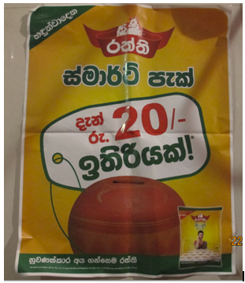
Please compare the declaration made on the poster with
Highland Full Cream Milk powder
Price of Ratthi 300 g Smart Pack is Rs. 270.00
(accordingly price of Ratthi 100 g is Rs. 90.00)
Price of Highland 400 g pack is Rs. 325.00
(accordingly price of Highland 100 g is Rs. 81.25)
saving to the consumer can be calculated as Rs. 26.25.

Slide 33

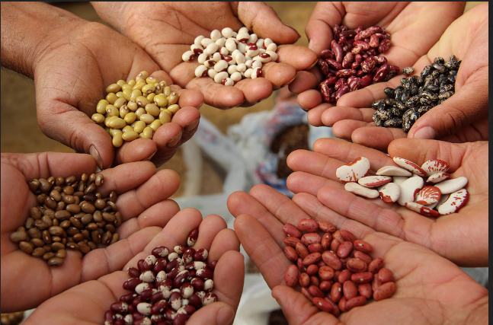
There is only one boss. The customer.
And he can fire everybody in the company
from the chairman on down, simply by
spending his money somewhere else.
“Sam Walton”

Slide 34
Consumer Organizations
Consumers International (CI) is the world federation of consumer groups that serves as the only independent and authoritative global voice for consumers.

Slide 35
CHOICE is an Australian non-profitable consumer Organization.
founded in 1959 which researches and campaigns on behalf of Australian consumers.
CHOICE tests and rates a range of products and services, including appliances, baby products, electronics and home entertainment, computers, food and health and financial products and services. More than 170,000 people subscribe to CHOICE.

Slide 36
Consumer activism can be seen even in Botswana
Consumer Watchdog is a division of Business & Enterprise Solutions Botswana (Pty) Ltd, a privately owned company registered in Botswana.
Consumer Watchdog has a wide reach regarding consumer issues in Botswana.

Slide 37
Which? is a brand name used by the Consumers' Association in the United Kingdom
A pressure group based in the United Kingdom that exists to promote informed consumer choice in the purchase of goods and services, by testing products, highlighting inferior products or services, raising awareness of consumer rights and offering independent advice.

Slide 38
Consumer Guidance Society of India (CGSI)
The Consumer Guidance Society of India (CGSI) is a consumerright organization based in Mumbai, India.
It was a consumer’s organization founded by nine women in 1966, and became the first to conduct formal product testing in 1977. CGSI publishes a magazine, Keemat.

Slide 39
Achievements and features of Consumer Guidance Society of India
It pressed for Consumer protection Act and Consumer Protection Court in 1975. Consumer protection court materialized in 1975 itself.
70-80% of the complaints received by CGSI are redressed
It was the first consumer organization to establish a formal product testing lab in 1977.
It was the first to start a monthly magazine called 'Keemat' which provided information to consumers

Slide 40
Achievements and features of Consumer Guidance Society of India
CGSI promotes consumer education, undertakes training programs in rural areas and represents consumer interests in government and other bodies
It won a national award in 1991 for consumer protection
It is also a member of state consumer protection council
It also takes part in a large number of technical committees and government decision making bodies.
Guides how to file the case in consumer court.

Slide 41

Sri Lanka needs similar organizations or groups to safeguard the consumers.

Slide 42

Be an informed & vigilant consumer
Unite and act for consumer rights.

Slide 43

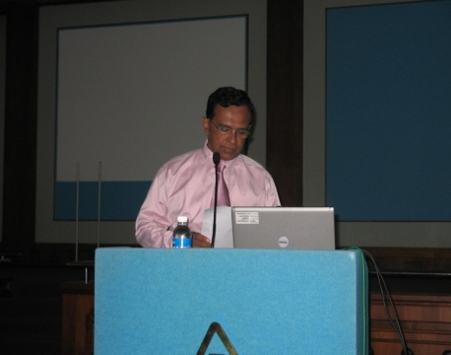
Thank you
  P.Madarasinghe
  Tel: 077 355 9758
  E-mail : preammadarasinghe@gmail.com

Slide 45
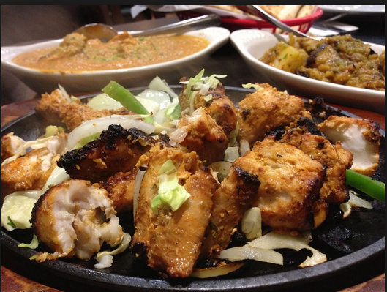
Be an informed & vigilant consumer
Be an informed & vigilant consumer.

Slide 46
Lets see how
we are cheated

Slide 47
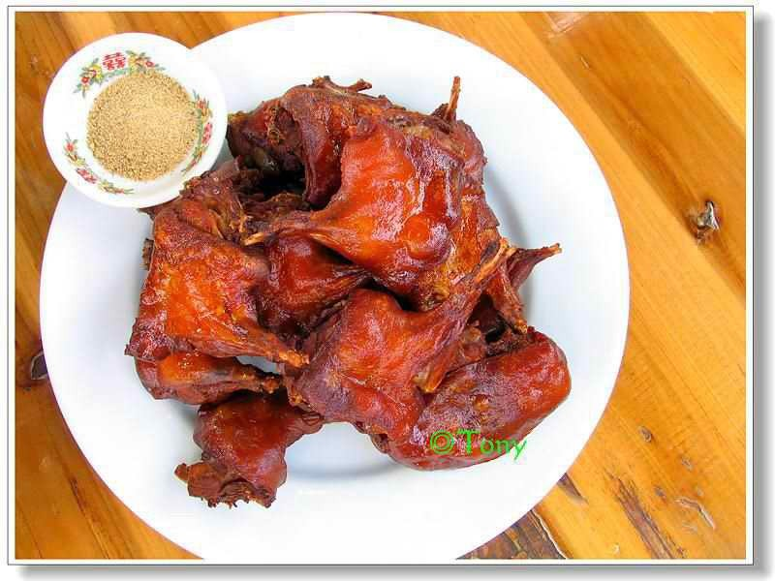

Slide 48
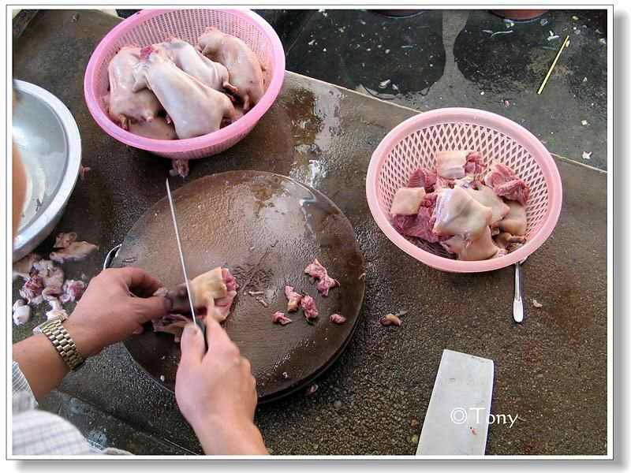

Slide 49
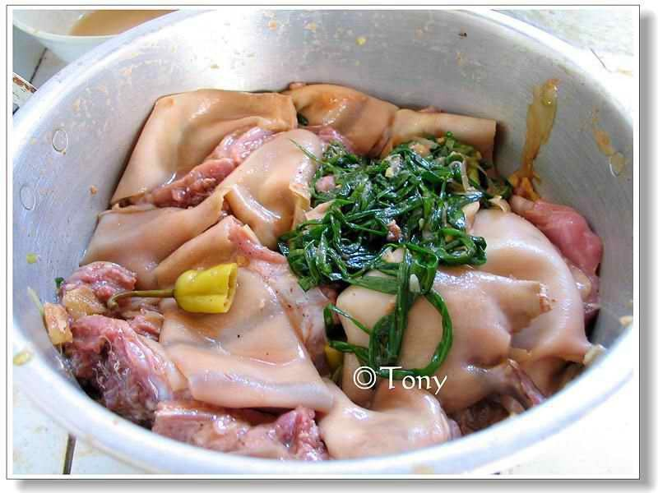

Slide 50
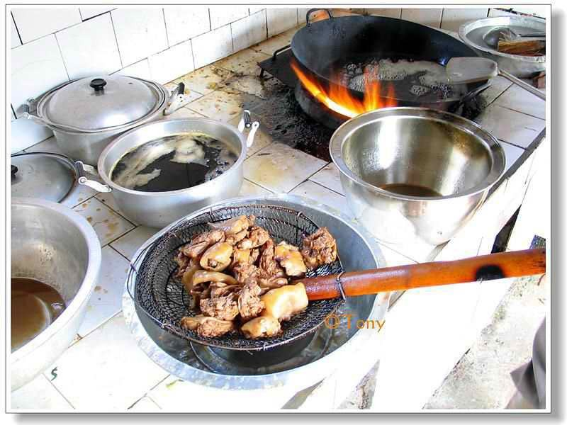

Slide 52
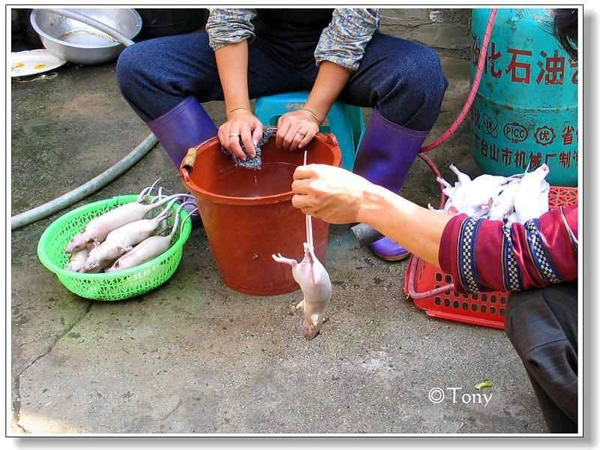

Slide 53
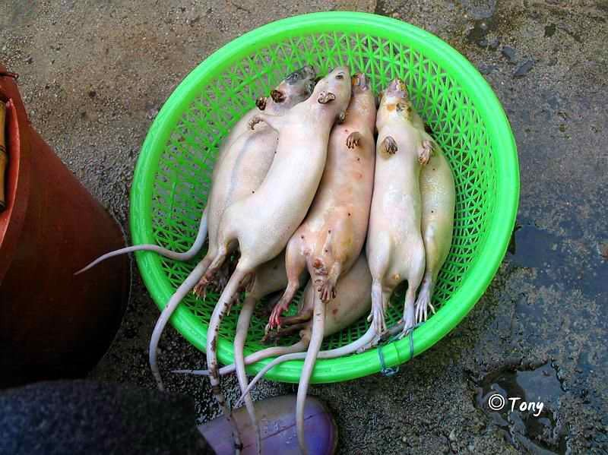

Slide 54
So this is
basically what
counterfeit is.

