Slide 1
Women’s Labour,
Livelihoods and
Economic Democracy
FIAN Workshop
Niyanthini Kadirgamar

Slide 2
ESCR vis a vis Women
Economic ideology and policy direction
  neglected ESCR since the neoliberal turn
Constitutional Reform
  motivations for including ESCR? Motivations for equality for women?
Women vis a vis – education, health, housing, food and work
  differences between men and women
Women’s Labour

Slide 3
Women’s Labour / Livelihoods
How do we understand women’s labour within the structure of Sri Lanka’s economy?
How are women and livelihoods envisioned in government’s economic policy proposals?
What is happening to women’s livelihoods amidst the global pandemic and economic depression?
How are women situated in relation to economic democracy?

Slide 4
How do we understand women’s labour within the structure of Sri Lanka’s economy?
Mainstream way of describing women’s labour
  Labour force participation: 30 – 35% for the past 20 years
  Supply / Demand factors
  Public / Private sector
    Private – 60% in the informal sector
  Wage gap
    male > female 30 to 36 % (private sector/semi-government organizations)

Slide 5
How do we understand women’s labour within the structure of Sri Lanka’s economy?

Slide 6
How do we understand women’s labour within the structure of Sri Lanka’s economy?
Source: ILO

Slide 7
How do we understand women’s labour within the structure of Sri Lanka’s economy?
Source: ILO

Slide 8
How do we understand women’s labour within the structure of Sri Lanka’s economy?
Source: ILO
Economically Inactive?

Slide 9
Historical shifts in SL’s economic structure
Structural Adjustment
  EPZs
  Migration
    Rural to urban
    Foreign countries

Slide 10
Social Reproduction
reproducing labour, reproducing society
  House-work / care-work
    Labour?
    economic value?
struggles around social reproduction
crisis of care-work
Value?
Labour

Slide 11
Land Ownership and Land Use
Household / Family as a unit of measure by economists
  invisibilises inequalities within
Women’s relationship to land
  Subsistence
  Organic
  Environment

Slide 12
How are women and livelihoods envisioned in government’s economic policy proposals?
Budget 2021
  A budget (NOT) for our times….
  Entrepreneurs -> self-employment
  Borrowers -> microfinance
2016 | Indebted Households (%) | Average amount of indebted households (Rs.)
 |  | Banks | Finance Institutions | Workplace | Loan Sharks | Credit card | Shop | Pawning | Leasing | Other
Sri Lanka | 59.7 | 337, 855 | 428, 139 | 230, 393 | 125, 992 | 62, 548 | 8, 188 | 100, 783 | 26, 514 | 83, 730
Source: ILO

Slide 13
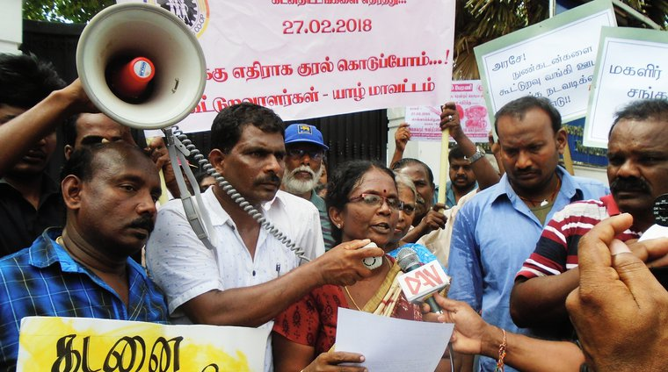
Protests against microfinance companies

Slide 14
Conceptualising women’s labour
women’s labour
ESCR
neoliberalism
Subsistence / informal

Slide 15
Employment vs Livelihoods
Potential and Diversity
Household vulnerability
Labour productivity
Autonomy
Collectivity
“A livelihood is a chain of being. It connects work to ecology, to a sense of community with nature. Livelihood has implicit in it two forms of access: access to nature as a commons and also to the means of production, consumption, distribution and renewal. Renewability involves all three processes: production, consumption and distribution. In recycling livelihoods, you recycle both nature and community. Thus we sustain both over time.” – Ela Bhatt

Slide 16
Global Pandemic and Economic Depression
Health
Poverty
Malnutrition
Education
Crisis for capitalism
  Unemployment
  Local Production
  Return to the rural

Slide 17
Social Security
Samurdhi
  Cash transfer
  Social Development
  Micro loans

Slide 18
Rise of Authoritarianism
Masculine / Militaristic / Paternalistic
Convergence of different ideological strands – women’s oppression
Attacks on cultural rights

Slide 19
Women and Economic Democracy
Participation
  Cooperatives, farmer collectives, WRDS
Mobilising / movement building

