Slide 1
Faddy is life…..Culture and every thing of rural people
Sri Lanka

Slide 12
Bio Diversity………………..

Slide 43
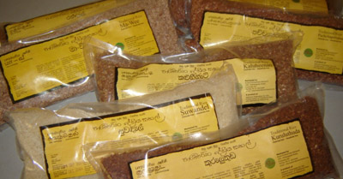
Today marketing……….

