Slide 1
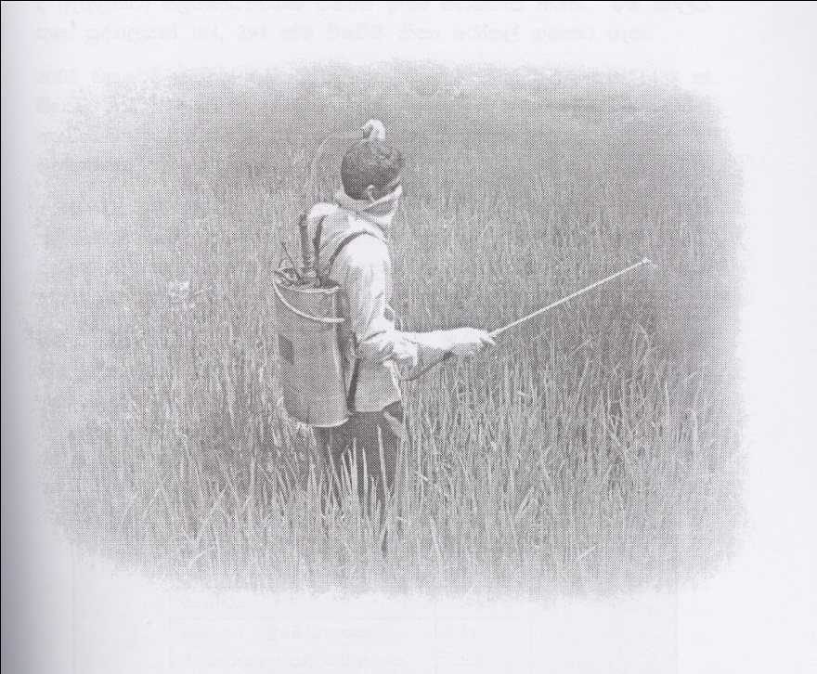
jsi yd ne|Qkq b;sydih
;s,la ldßhjiï

Slide 2
1939 -
m,sfndaOkdYl fidhd .ekSu hgf;a hï id¾:l ;;a;ajhla f,i D.D.T. (Diehloro – diphencyl – trichlorotheng) ) uef,aßhdj u¾Okhg fhdod .eksu‘
1949, Dr. Paul Muller won the Nobel Prize in Medicine for discovering its insecticidal properties.

Slide 3
1950-1960
ridhksl m<sfndaO ksIamdokh f,dalh mqrd by, hñka" yß; úma,jh m%p,s; lsßug msgqjy,la ,ndfok ,§

Slide 4
1962
ksy~ jika;h ZZ ,shq ßfp,a ldika fukjsh f,dalf.a m<uq jrg m%isoaêfha m<sfndaOkdYl udkj fi!LHhg yd mßirhg lrk n,mEu lreKq iys;j t,s±laùu'

Slide 5
1968 - 69
ks¾,cacd iy.; f,i weußldkq yuqodj fkdfhl=;a ridhksl iys; m,sfndaO kdIl iy úúO wfkl=;a úI úhÜkdï hqoaOfha§ ñksia >d;khg yd iiS%l úhÜkduh úkdY lsÍug fhdod .eKsks'

Slide 6
1980
wka;¾cd;sl jYfhka ms,s.;a kS;s rS;s rduqjla .ek Wkkaoqj yd ish¿ lreKq mokï lr.ksñka m,sfndaO kdYl j,g tfrys /,a, jeä ùu u.ska wka;¾ cd;sl wdh;khka fj; t,a,jQ fpdaokd mokï lr .ksñka thg úiÿula f,i hï iïuq;Skag meñKSu th '
In the late 1980s, a tightening of environmental regulations in industrialized countries led to a dramatic rise in the cost of hazardous waste disposal. Searching for cheaper ways to get rid of the wastes, “toxic traders” began shipping hazardous chemical to developing countries and to Eastern Europe. When this activity was revealed, international outrage led to the drafting and adoption of the Basel Convention.

Slide 7
1980 • ,xldj ;=,
Control of Pesticide Act - No 33 of 1980
m<sfndaO md,k mk;

Slide 8
1984
fndamd,a fÄojdplh ish¨ fokdf.a weia werjkakla fukau' wka;¾cd;sl f,i m%;sm;a;s iïmdolhka yd nyqcd;sl wdh;khka wmyiqjg m;alrkq ,enq wñysß w;a±lSula fukau fkdkj;sk ñksia ixydrhla o úh'

Slide 9
1986
p¾fkdí,a fÅojdplh

Slide 10
1994
Control of Pesticide Act (Ammendment) - No 06 of 1994
m<sfndaO md,k mk;g (ixfYdOk)

Slide 11
1996
frdg¾vEï iïuq;sh

Slide 12
2001
iafgdlafydaï iïuq;sh

Slide 13
2000 ka miq jl=.vq frda.h
2003 – 2005 - maf,drhsâ
2006 - 2008 - nerf,day ( leâñhï
2009 – 2010 - kS, yrs; we,a.S
2010 – 2011 - wdiksla

Slide 14
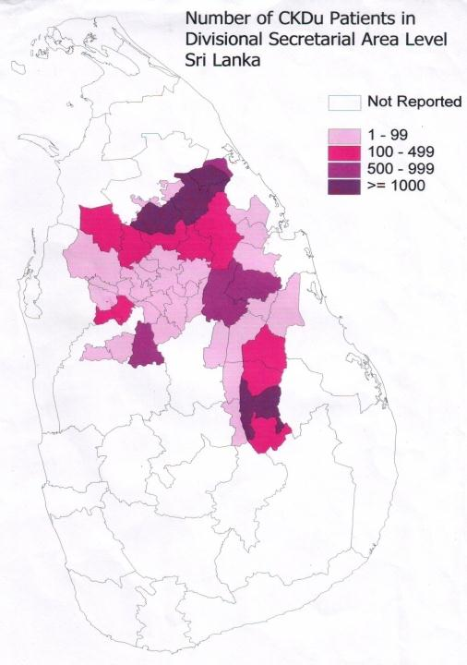

Slide 15
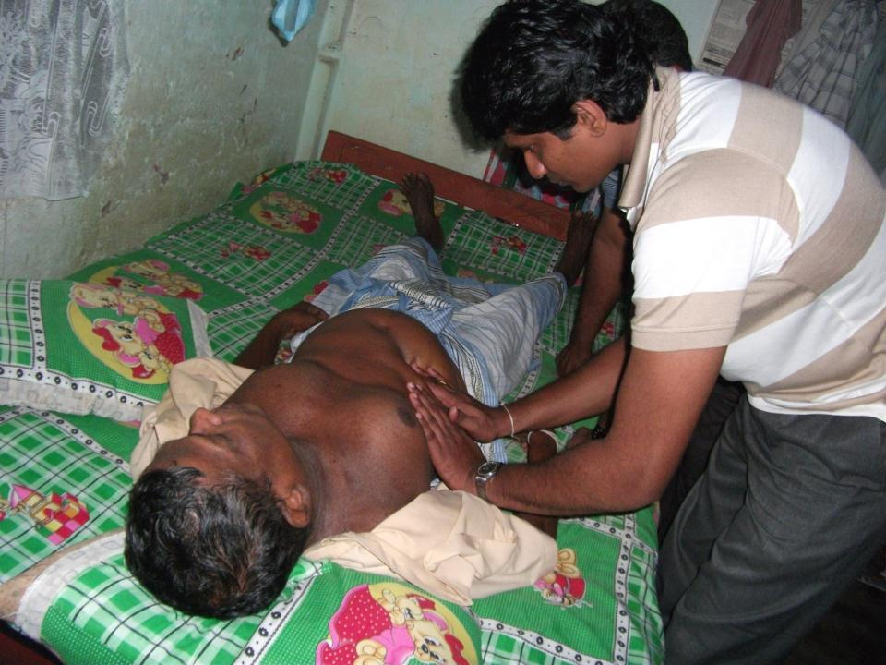

Slide 16
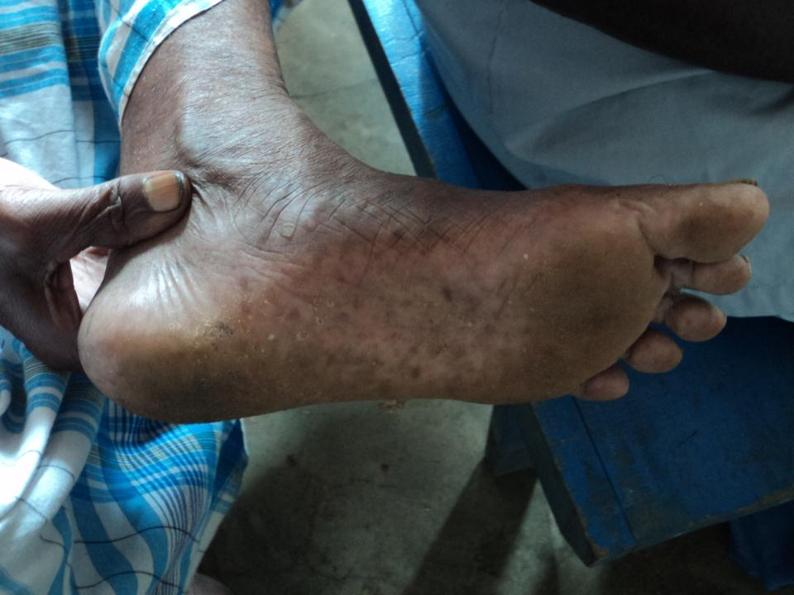

Slide 17
Mandate
The main function of this office is enforcement of the Control of Pesticides Act No. 33 of 1980, it's amendments and regulations. The Act provides provisions to control, import, packing, labeling, storage, formulation, transport, sale and use of pesticides through registration of individual products. The entire spectrum of pesticidal products, such as those used in agriculture, public health, domestic, industrial and veterinary etc. are coming under the purview of the Act. The office of the Registrar of Pesticides has the national responsibility to ensure that only the high quality pesticides those are least hazardous to human health and enviroment enter the market in Sri Lanka.

Slide 18
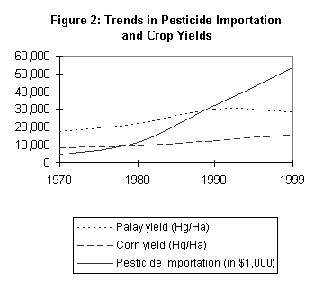
wdodhug fudlo fjkafk

Slide 19
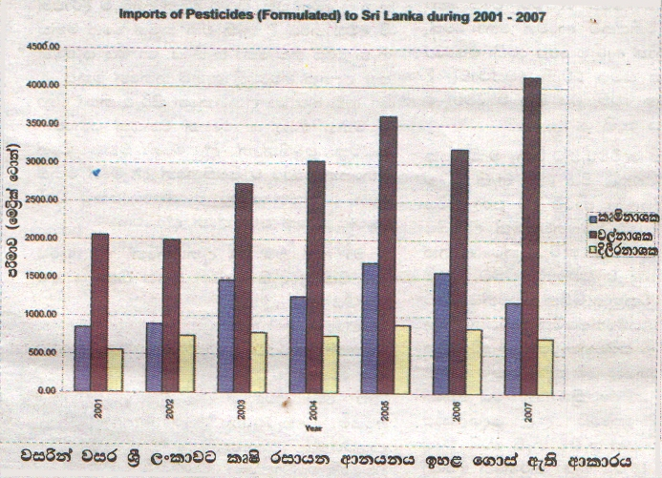

Slide 20
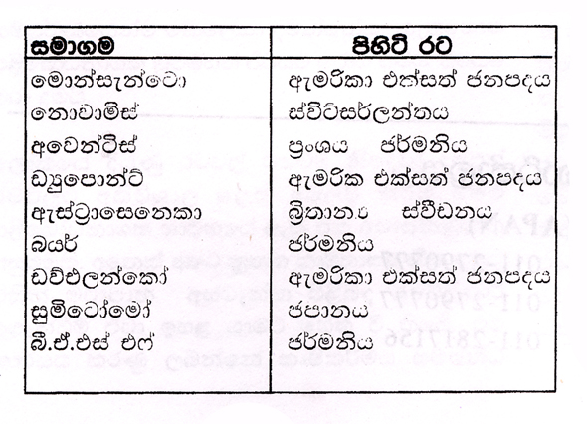
kQ;k wfma foújreka

Slide 21
wfma foúhd
The Syngenta Foundation for Sustainable Agriculture is launched.The Torrey Mesa Research Institute (TMRI), the genomics research center of Syngenta, completes the Rice Genome Map in collaboration with Myriad Genetics Inc. Syngenta inherits the strengths and traditions of two excellent companies. However, it will have a clear personality of it own. Our name, Syngenta, has two distinct roots. "Syn" stems from Greek. It reflects synergy and synthesis, integration, and consolidating strengths. "Genta" relates to humanity and individuals. It stems from the Latin "gens," for people or community. So Syngenta means "bringing people together."

Slide 22
iskafckagd iy wj;dr

Slide 23
m<sfndaOkdYl Tfí fi!LHhg wys;lrhs
wjg mrsirhg
i;a;aj m%cdjg
udkj j¾.hdg

Slide 24
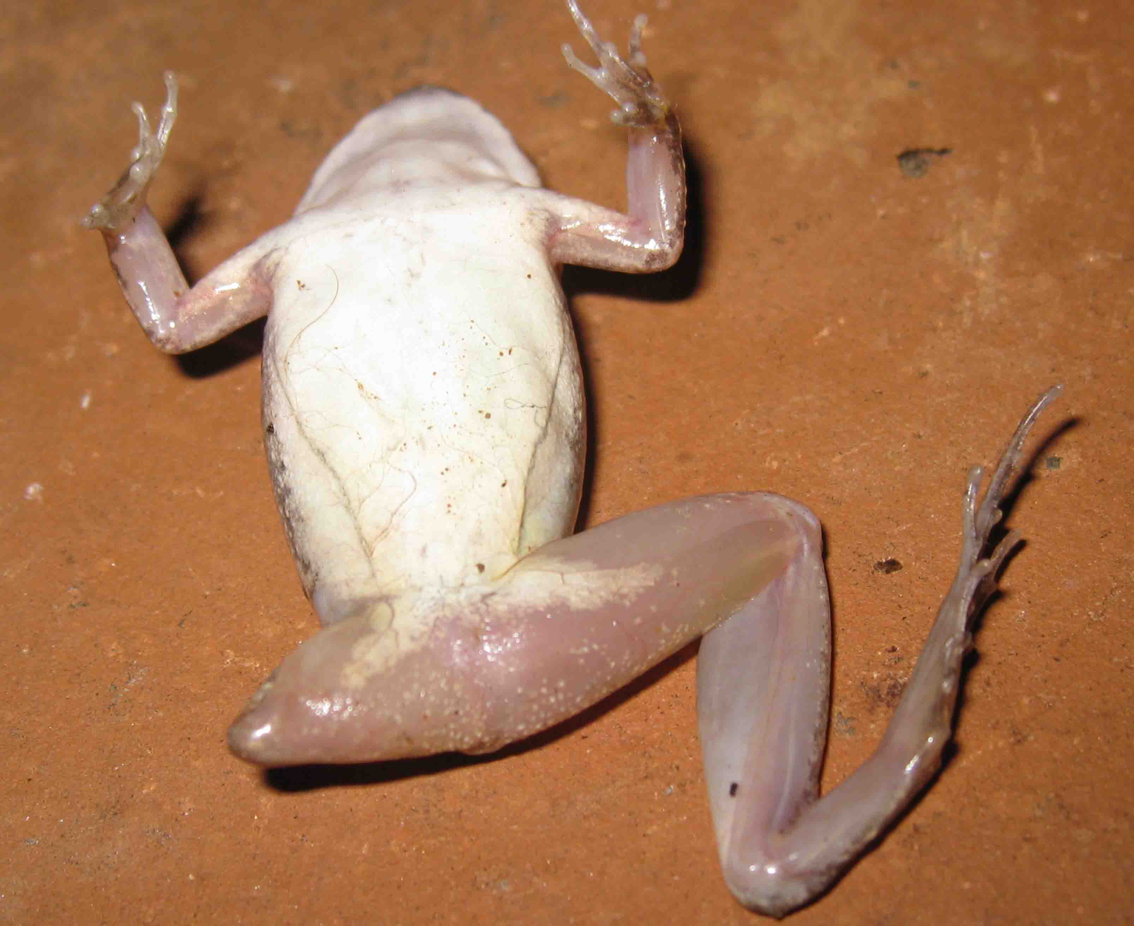

Slide 25
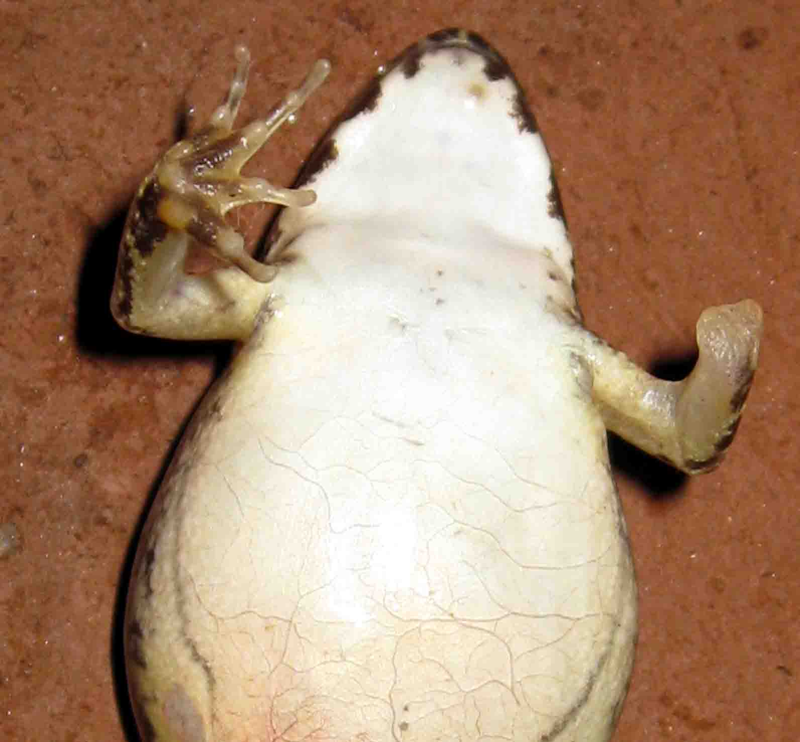

Slide 26
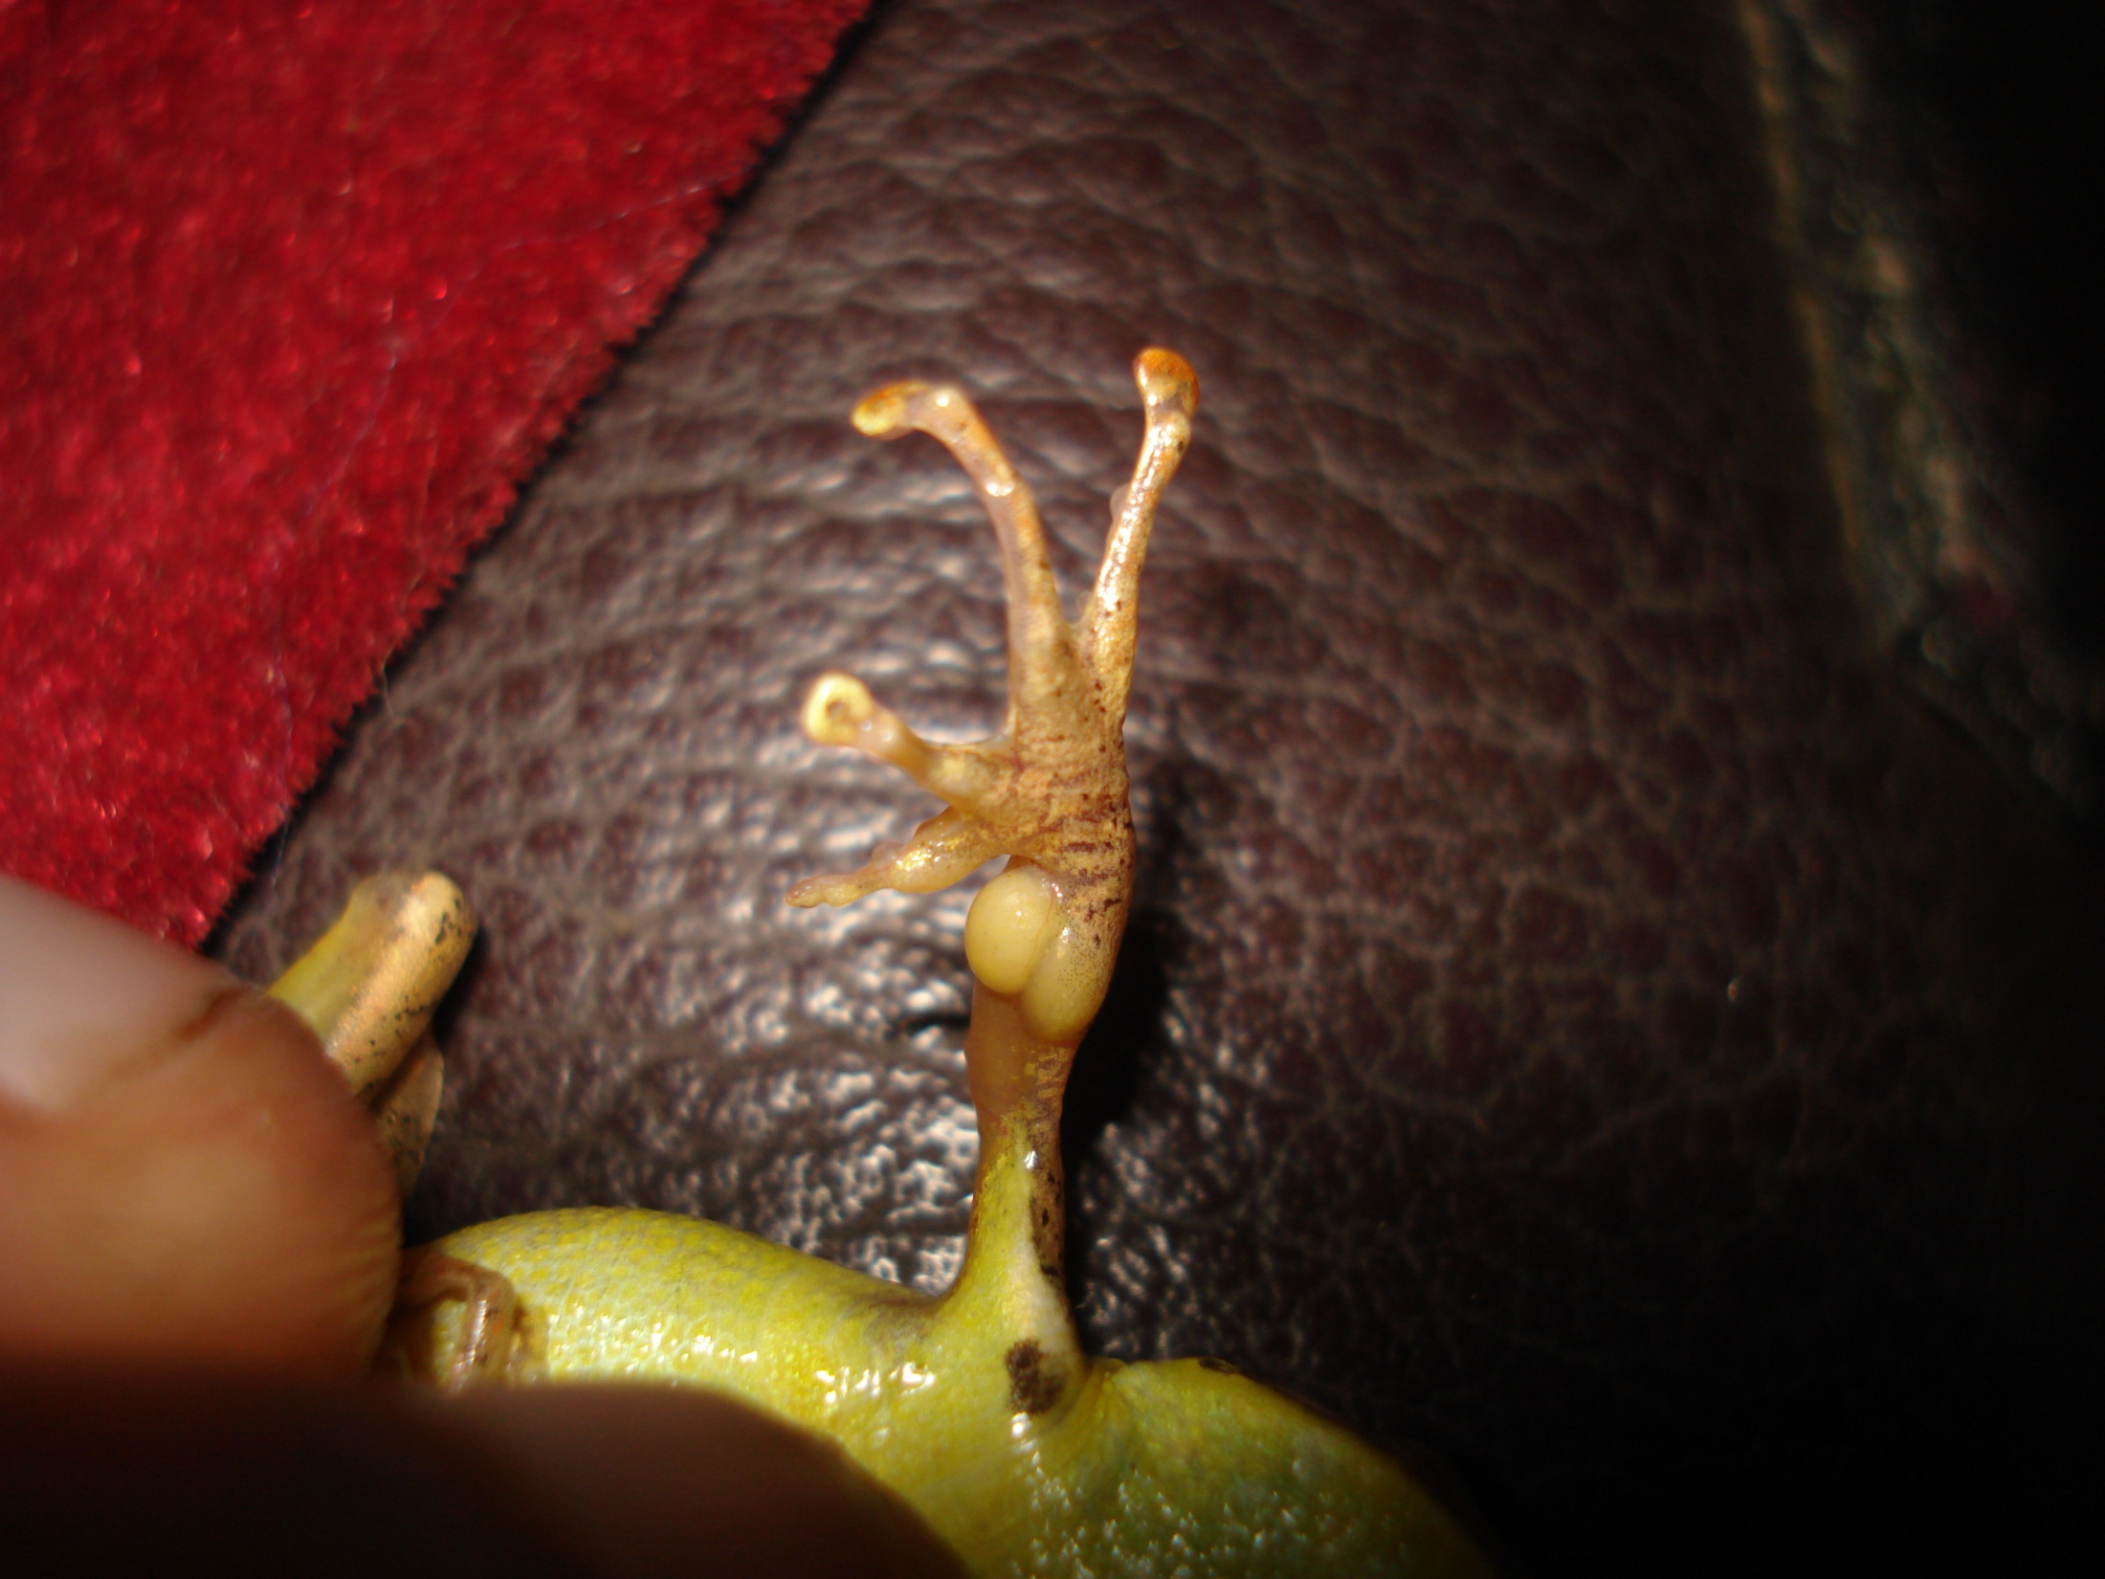

Slide 27
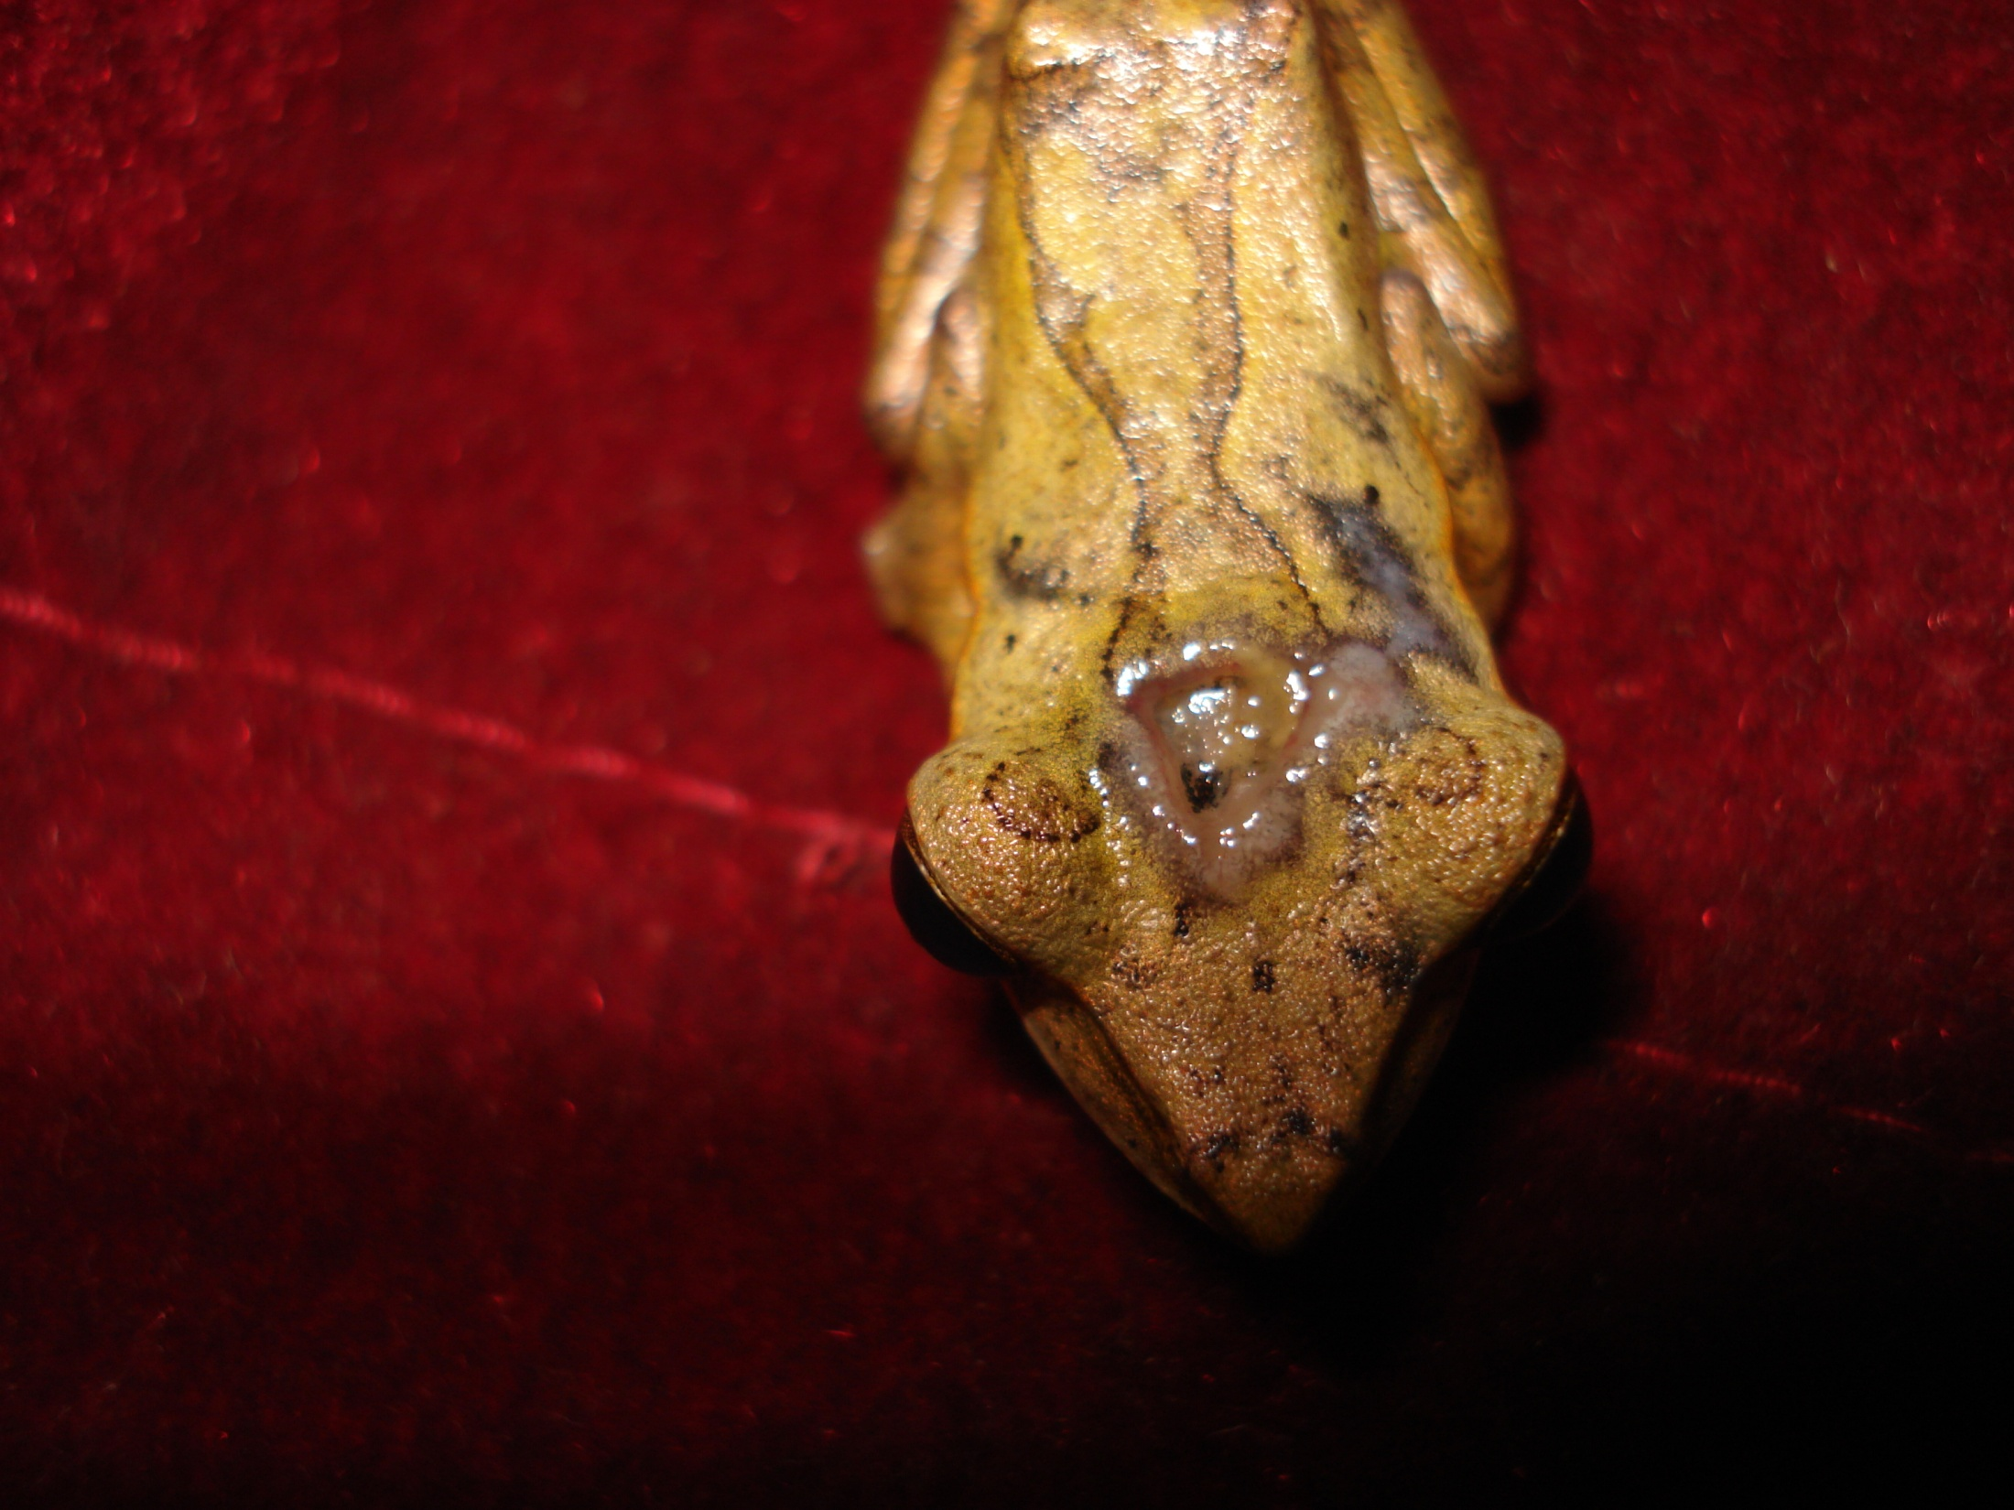

Slide 28
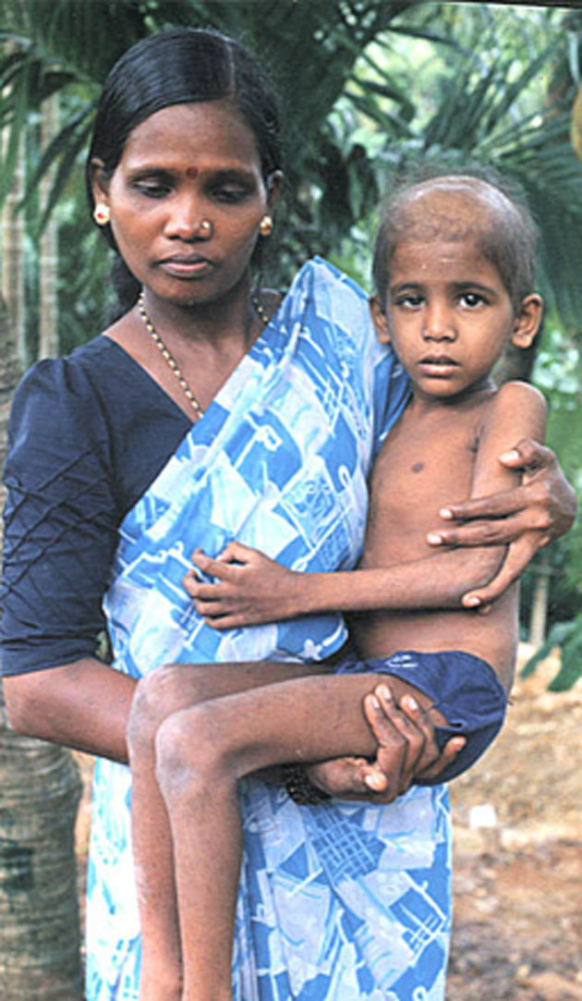

Slide 29
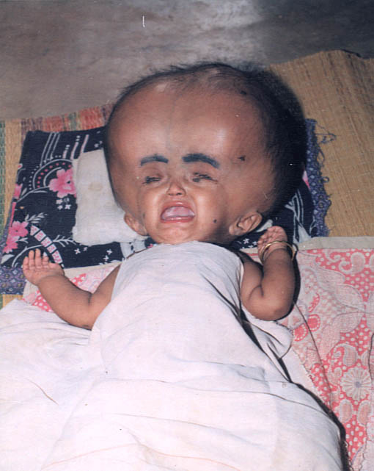

Slide 31
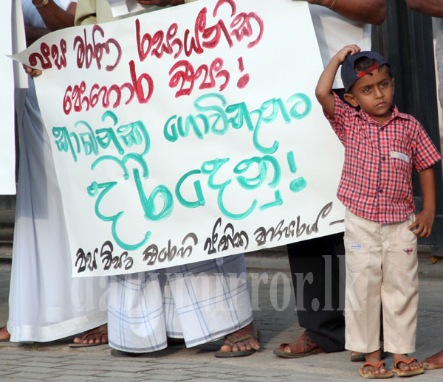

Slide 32
kQmka orejka fjkqfjka
ji úI m%fõYfuka fkdj fldfy;au
mdúÉfhka j,lsuq

