Slide 1
Sri Lankan Traditional Rice Varieties still valid…..
Thilak Kariyawasam
Chairman
SLNG / LOAM

Slide 2
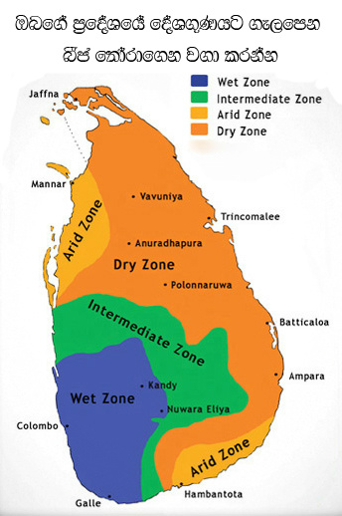
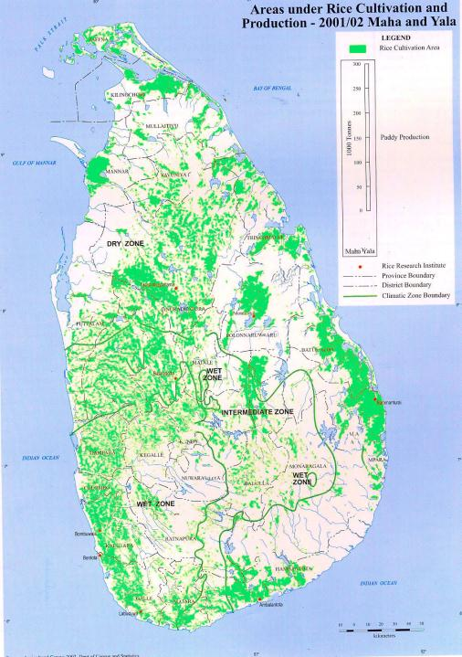
Sri Lanka…..

Slide 3
Background……………………..
Rice is the most important crop 34% (0.77 /million ha) of the total cultivated area in Sri Lanka.
On average 560,000 ha are cultivated during two seasons, maha and 310,000 ha during yala seasons.
Approximately 1.8 million families are engaged in paddy cultivation island-wide.
Sri Lanka currently produces 2.7 millions of rough rice annually and satisfies around 95 % of the domestic requirement.

Slide 4
…. production……
Traditional rice varieties have been conserved, developed and used by Sri Lankan farmers over a period of more than 3000 years.
The mere existence of more than 2400 varieties in the 1950s in Sri Lanka explains the agro-bio diversity values of traditional rice.
Today 3% traditional rice varieties been used by different farmer groups in different areas in the country.

Slide 5
specific nutritional/medicinal properties
heenati rice was grown for lactating mothers.
Kanni murunga, was grown for men going out to work in the fields. it gave them energy as it contained a lot of carbohydrates.
Suvandel was cultivated for its extraordinary fragrance
Monks who did not eat after noon were given mawee, which possesses a high protein content

Slide 6
Traditional varieties of Sri Lankan rice…
products to give a feeling of volume and thickness to the hair. It is also reported to have moisturizing and anti-ageing properties. Traditional varieties of Sri Lankan rice are known to contain higher amounts of glutamic acid, higher concentrations of vitamins and the coarse grains are also richer in fiber content. They are also said to have a high nutritive value

Slide 7
Not only for their varying nutritional value
But also according to their suitability to the different growing seasons, water variations, climatic variations, resistance to different types of pest.
In many cases this method of farming was far more efficient than contemporary methods, less irrigation was needed, the rice could be stored for longer and natural fertilizer coupled with carefully chosen strains of rice suited to particular climates ensured successful yields.

Slide 8
With last decade we can see….
tendency among some of farmer groups promoting different type of traditional rice varieties in the country and outside export as well. Government haven’t had supported for these activities. It was totally farmer led process with support of nongovernmental organizations. Today there are different brand with traditional rice varieties in super market from farmer groups, farmers and private companies. Those are in the different prices, when you compare with normal price is traditional are 3 time high prices

Slide 9
With the goal of returning traditional rice farmers back to the fields…..
Existing un productive lands as traditional rice cultivation areas
Donating seeds to farmers who will devote a certain proportion of their land to growing rice following traditional, organic methods;
Farmer led certification program for traditional rice varieties
Finding, up scaling and organizing national and international markets;
Making government structures to promote it and help schemes and subsidies

Slide 10
Today……
We are trying to do so in different ways………………..

Slide 11
Why ?
Traditional rice….. with Low production………………….
There are more reasons than that…..

Slide 13
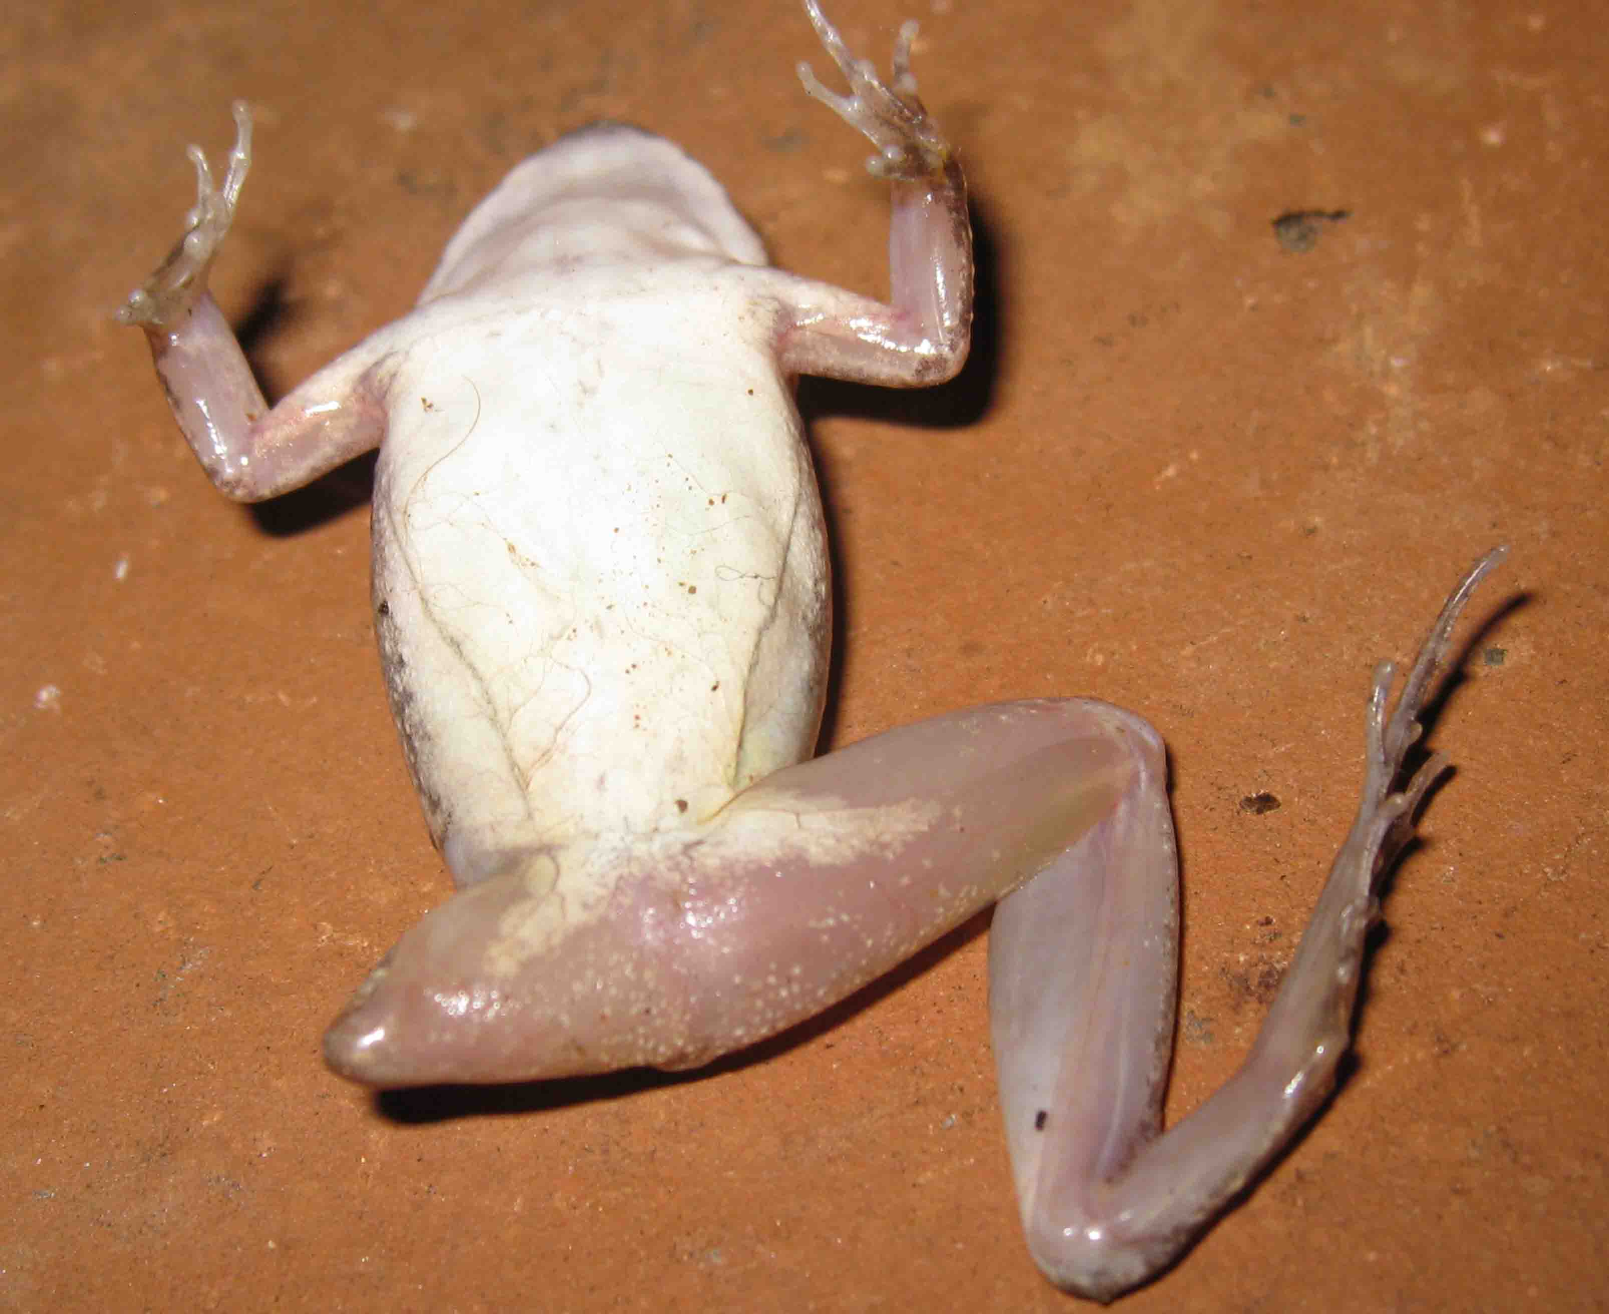

Slide 14
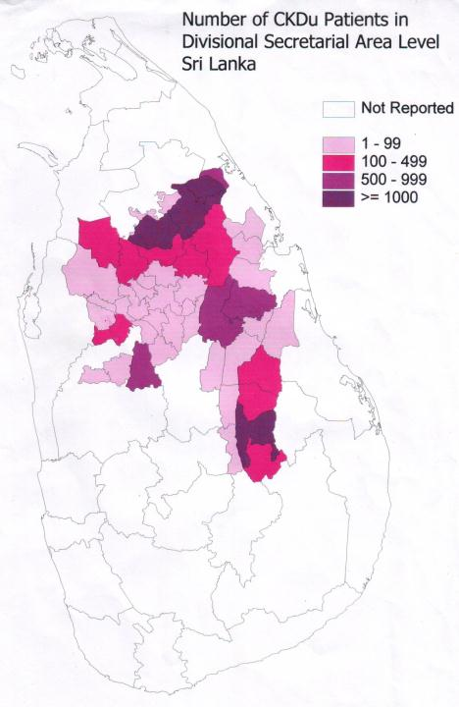

Slide 15
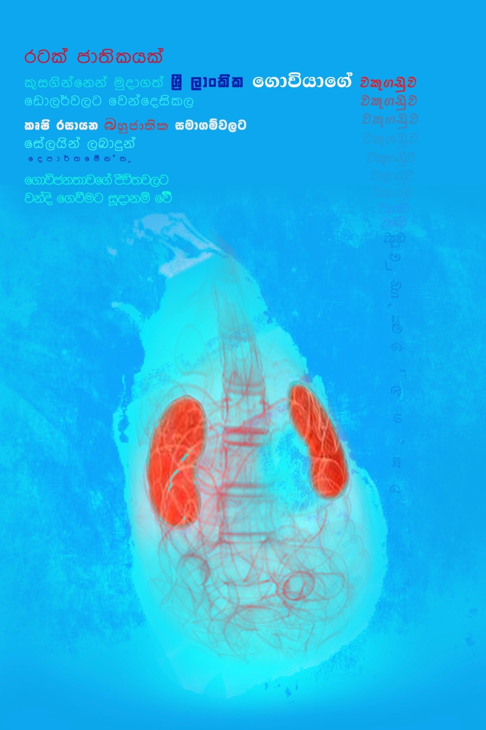

Slide 16
Arsenic in Rice
Chandrajith et al 2010 identified csomparatively high amount of As in rice collected from CKDu endemic regions (Giradurukotte and Nickawewa).(100-260ug/kg) But didn’t correlate the findings with disease prevalence.
Our analyses also revealed high amounts of As in rice which are compatible with that from West Bengal and Bangladesh (100-500 ug/kg)
Arsenic in hair samples
Chronic As poisoning was confirmed by high As levels in hair samples of CKDu patients. 3-10 mg/kg
In our samples 3.04-7.18 mg/kg As observed.

Slide 17
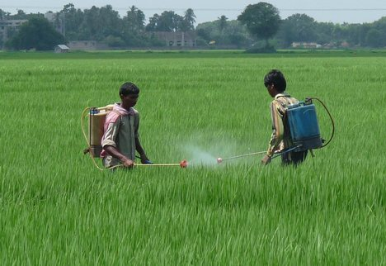

Objective II –Development of pesticide- free cultivation strategies for Sri Lanka

